Slide 1

Bank Loan Case Study
This Photo by Unknown Author is licensed under CC BY-SA
By. Kanchan Kumar Pandit

Slide 2
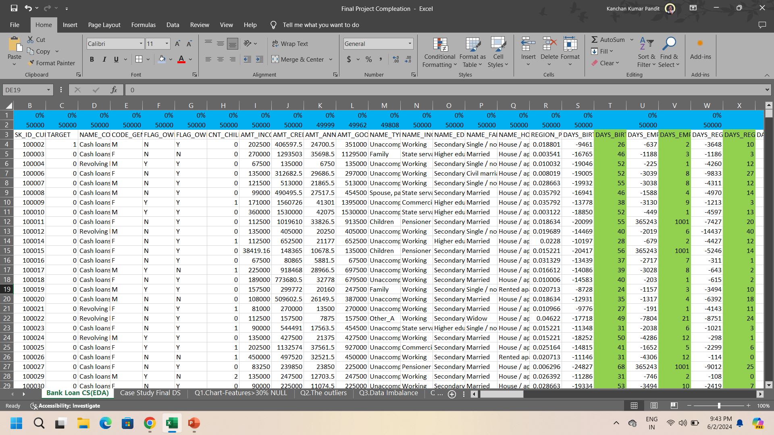
Data Filteration
Data after Filtration :Before cleaning the data there were 50000 rows and 172 columns. There are blank and data also available
upon removing the columns of more than 30% blanks Left with 62columns.

Slide 3
1.Data Filteration
Data after Filtration : Columns with >30% Null values representation

Slide 4
2. Outliers
To Calculate Q1 = QUARTILE(A2:A50000, 1)
To Calculate Q2 = QUARTILE(A2:A50000,3)
To find IQR = Q1 – Q2
Lower Bound = Q1-1.5 * IQR
Upper Bound = Q2+1.5*IQR
Here we are taking 4 outliers as Income, Children , Amount Credit, employment of Borrower

Slide 5
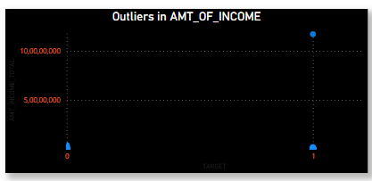
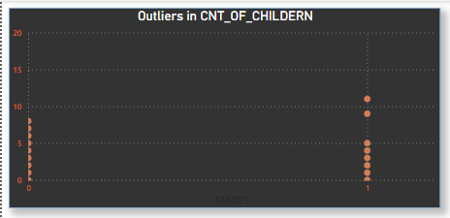
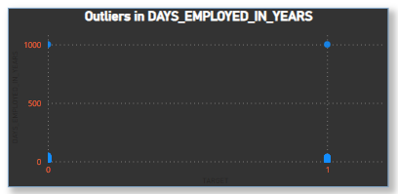
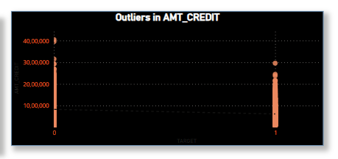
2. Outliers

Slide 6
3. Data Imbalance

Slide 7
4. 1. Univariate
Univariate Keeps and eye on unique object and evaluate mathematical expression with train the algorithm for accurate decision.

Slide 8
4. 1. Univariate

Slide 9
4. 2. Segmented Univariate

Slide 10
4. 3. Bivariate Analysis

Slide 11
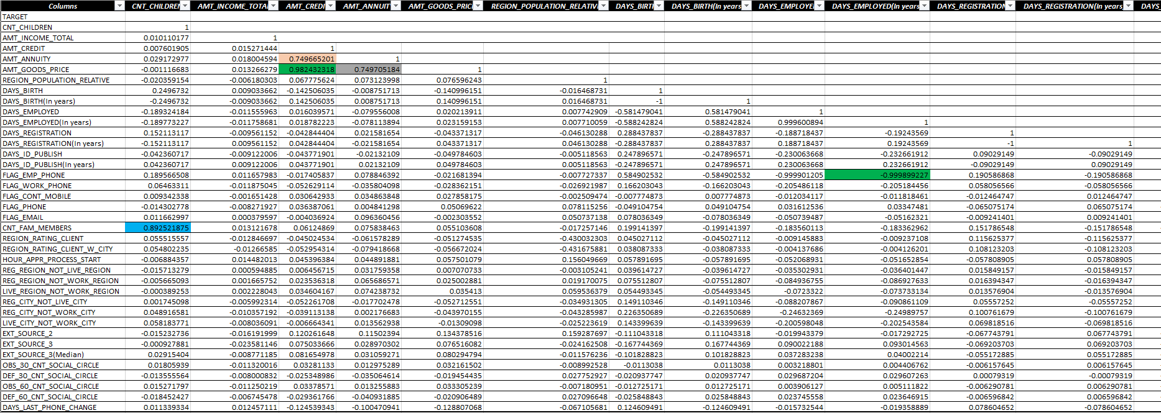
5.Different Co-Relation

